Slide 1

Topic: Graphing EQ: How do I use conversion graphs to change units?
Year 11 Essentials

Slide 2
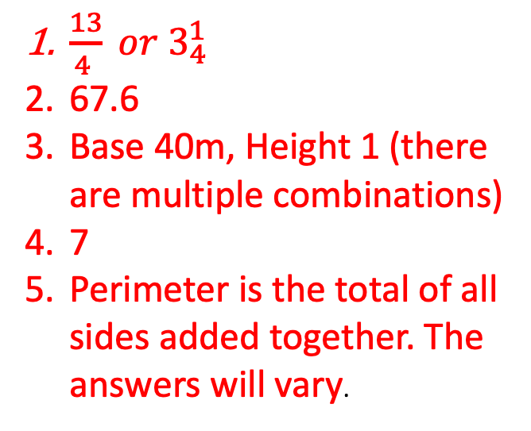
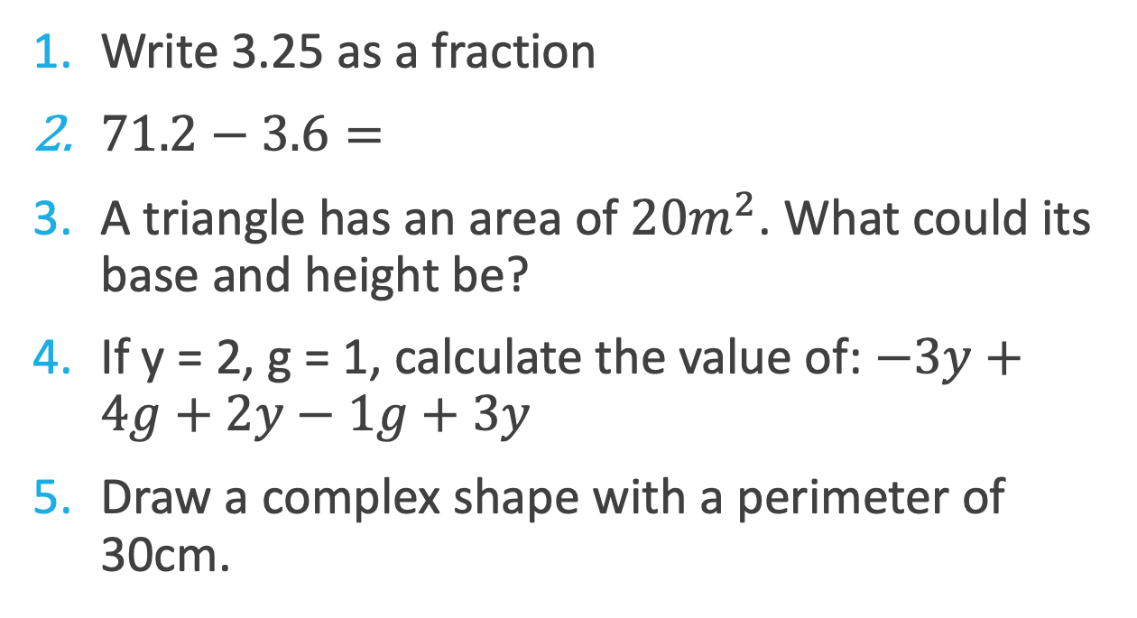
First 5
Topic: Graphing EQ: How do I use conversion graphs to change units?
Write 3.25 as a fraction
$71.2−3.6=$
A triangle has an area of $20m^{2}$. What could its base and height be?
If y = 2, g = 1, calculate the value of: $−3y+4g+2y−1g+3y$
Draw a complex shape with a perimeter of 30cm.
$\frac{13}{4 } or 3_{4}^{1}$
67.6
Base 40m, Height 1 (there are multiple combinations)
7
Perimeter is the total of all sides added together. The answers will vary.

Slide 3
Topic: Graphing EQ: How do I use conversion graphs to change units?
Conversion graphs are straight line graphs that plot two sets of data that measure the same change using different units.
They have two Number Lines for scales and are useful for quickly determining how many of one unit make up another unit.
What is a conversion graph?
Conversation graphs are useful in all situations beyond school and using them regularly help us to develop a ‘feel’ for converting numbers.
Where is it useful?
For Example:
Speed in kilometre per hour versus miles per hour.
Buying products online and converting to Australian dollars from other currency.
Comparing clothing or shoe sizes for different brands or countries.
Notes:
THS - See if students can come up with some examples for where are conversion graphs useful. Then move on to provide a few examples.

Slide 4
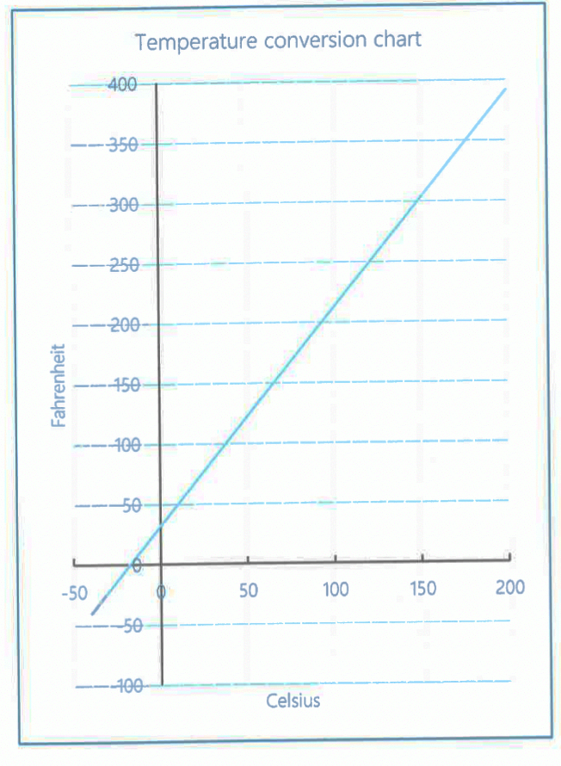
Topic: Graphing EQ: How do I use conversion graphs to change units?
Page 88.
TASK: With a partner answer the following questions. Be prepared to share.
Which axis shows the temperature in Celsius (˚C)? Which shows Fahrenheit (˚F)?
How can we use the numbers on one axis to tell us what the temperature is on the other axis?
What is temperature in Fahrenheit at freezing point?
When cooking, a recipe calls for a cake to be cooked at 375˚F. What should I set it to in Celsius (˚C).
Body temperature is around is around 98˚F. What is it in Celsius.
While speaking with an American on social media, they complained that the temperature was 90˚F. What does that mean in Celsius?
Notes:
Answer the first 6 questions as a we do activity. Give students time to think and answer questions then go through them as a class.

Slide 5
Topic: Graphing EQ: How do I use conversion graphs to change units?
TASK:
Complete Questions 7 -10 on page 89 of your text.
Notes:
I have also uploaded a worksheet on connect with some other conversion graphs and questions.

